Slide 1
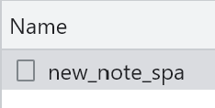
Browser
Server
The user types the “note” in the text field, then submits the form. The browser sends user input to the server as a POST request.
The POST request to the address new_note_spa contains the new note as JSON data containing both the content of the note (content) and the timestamp (date)
POST https://studies.cs.helsinki.fi/exampleapp/new_note_spa
JSON data
Status Code: 201
The server responds with status code 201 created. This time the server does not ask for a redirect, the browser stays on the same page, and it sends no further HTTP requests.
The new note is added to the notes list and rendered on the same page. In addition the note is sent to the server as a JSON data type

